Slide 1

C++ IMPLEMENTATION OF NELDER MEAD & SIMULATED ANNEALING AND COMPARISON WITH MATLAB
OPTIMISATION METHODS FOR ENGINEERS
Abhimanyu Bhadauria
Kristóf Sárosi

Slide 2
Contents
Aim
Simulated Annealing
Nelder Mead (Downhill Simplex)
Results & Comparison with Matlab
Parallel Implementation
Improvements

Slide 3
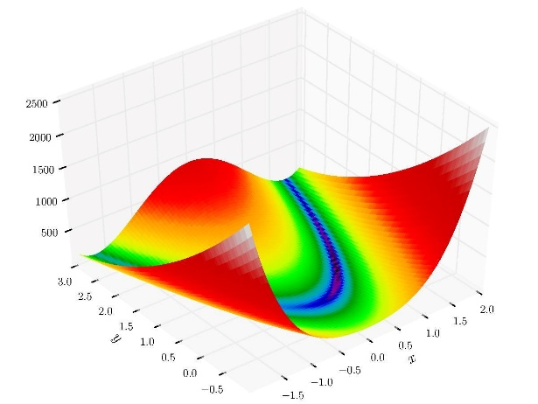
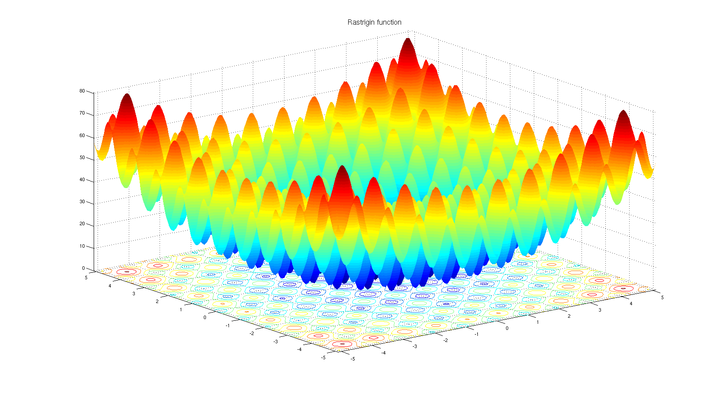
Aim : What We Set Out To Do
Implement Simulated Annealing & Nelder Mead from scratch using C++
Benchmark it on frequently used test functions
Compare results with corresponding methods available in MATLAB
Implement methods in parallel using MPI and see if there is any improvement to be had
Test Functions Used for Benchmark
Rosenbrock Function
Smooth function with 1 global minima on N-dimensional domain
Rastrigin Function
Non-Smooth function with 1 global minima but many local minima on N-dimensional domain

Slide 4
Simulated Annealing
Stochastic
Guaranteed to find global optimum, given enough time
Can accept points that have a worse fitness than current
Parallelization relatively simple
Also works well with test functions with multiple local minima (non smooth)
Start
Pick random start point
Do while convergence
Do while accept count < 100
Next = Current + Random
Check boundary
If next < current
current = next
accept count ++
else if next >= current
check probability
accept worse point
accept count ++
Reduce temperature
End

Slide 5
Nelder Mead (Downhill Simplex)
Does not guarantee to find global optimum
Prone to getting stuck in local optimum
Can add stochasticity with random restart
Simple but ineffective for non smooth functions (strong variations)
Parallelization quite simple to achieve
Start
Generate random d+1 simplex
Do while convergence
Sort fitness of each point to find best
Find barycentre
Modify simplex
Replace worst point
reflect & extend
contract inside or outside
Shrink if no good point found
Restart if stuck in local minima
End

Slide 6
Serial Results & Comparison : Simulated Annealing Cooling Scheme Parameter Tuning

Slide 7
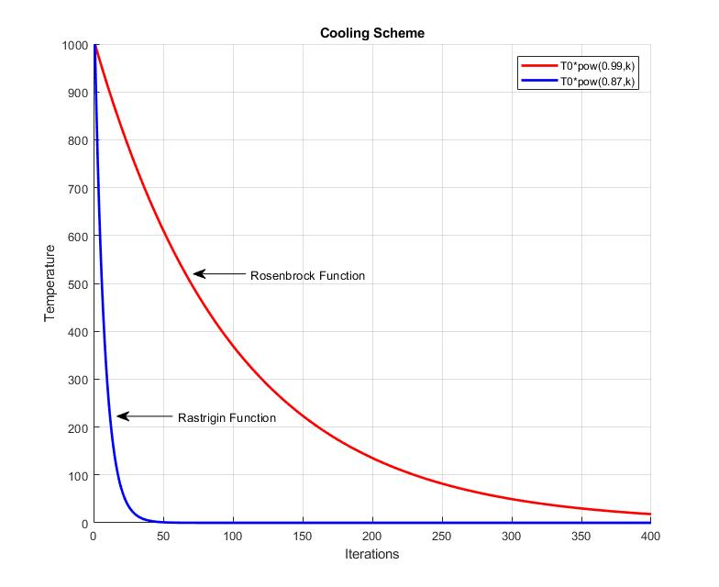
Serial Results & Comparison : Simulated Annealing Cooling Scheme

Slide 8
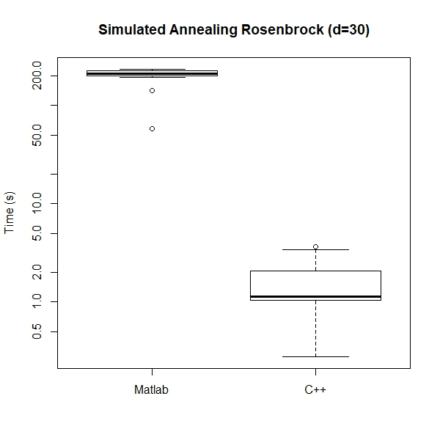
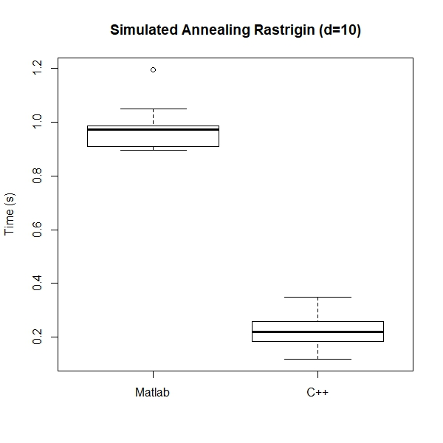
Serial Results : Simulated Annealing

Slide 9
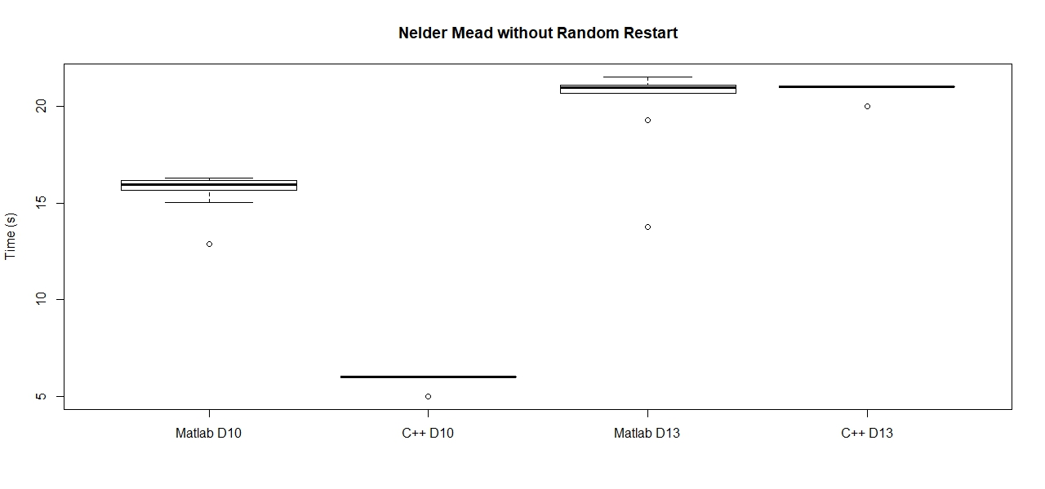
Serial Results : Nelder Mead without Random Restart Rosenbrock Function

Slide 10
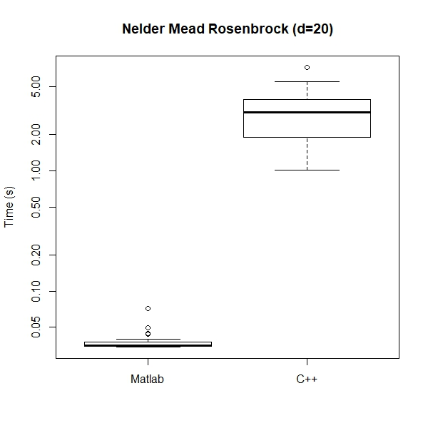
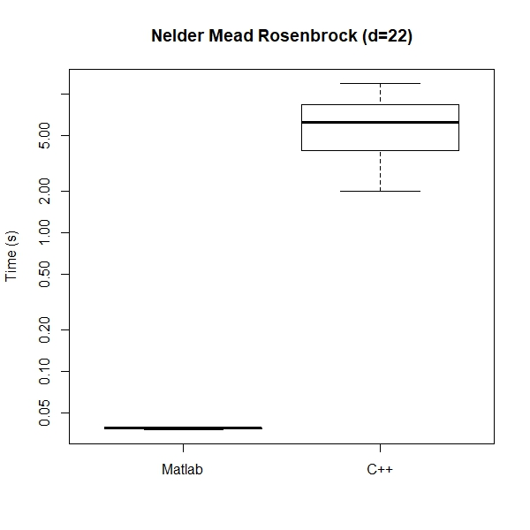
Serial Results : Nelder Mead with Random Restart

Slide 11
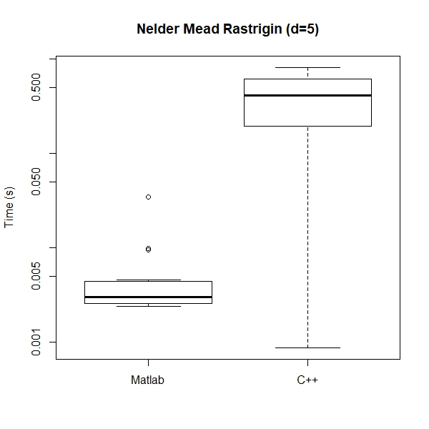
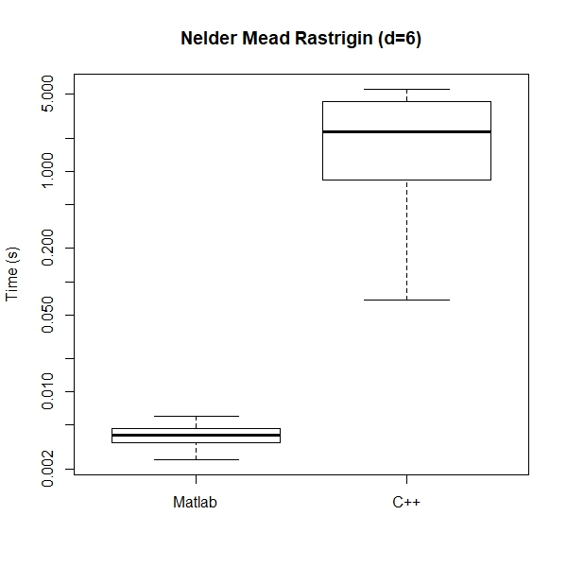
Serial Results : Nelder Mead with Random Restart

Slide 12
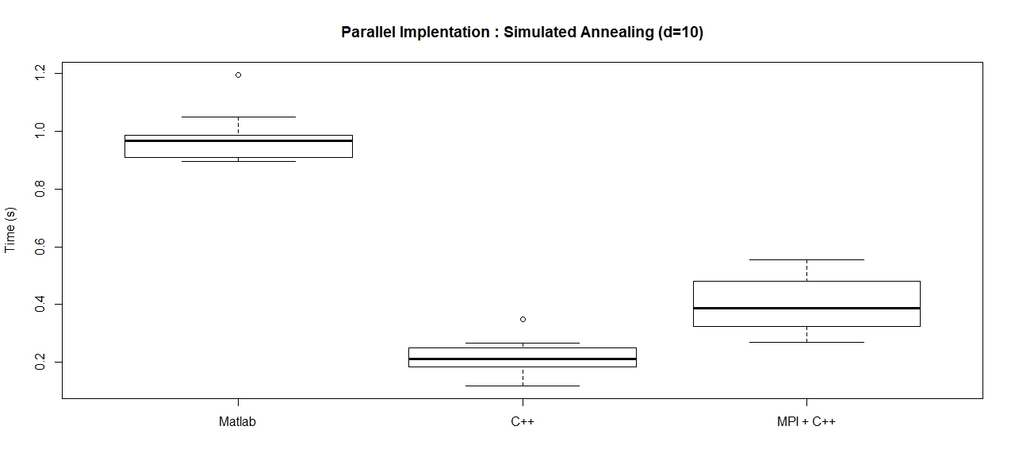
Parallel Implementation with MPI : Rastrigin Function

Slide 13
Improvements
Convergence of algorithms at higher dimensions still a concern (more so with Nelder Mead)
Parallel implementation could be improved vastly
Potentially better initialisation using a hybrid implementation

